Slide 1



E-LEARNING
BY
DIXITHA. R (111920CS01024)
CATHERINE JENISHTHA .J (111920CS01015)

Slide 2

WEBSITE TO LEARN ABOUT PROGRAMMING LANGUAGES
WEBSITE CREATED USING:
*html
*css
*Javascript

Slide 3

ABSTRACT
New and interesting technologies are being used for teaching. This means that you don’t need to be at school or at the university to take courses.
>>E-learning for:
* In this e-learning website provides
Programming languages .
>>E-learning works:
* E-learning can work as a virtual classroom, where students and teachers can communicate with ease no matter where they are in the world.

Slide 4

Introduction to fullstack
A full stack web developer is a person who can develop both client and server software. In addition to mastering HTML and CSS, he/she also knows how to: Program a browser (like using JavaScript, jQuery, Angular, or Vue) Program a server (like using PHP, ASP, Python, or Node)

Slide 5

Programming laguages
A programming language allows people to create programs that tell machines what to do.
The 1st programming language was developed in 1883 when Ada Lovelace and Chaeles Babbage worked together….
In this website the programming languages are there to learn how for users to interact with machines. *eg.Java,c,c++,etc

Slide 6
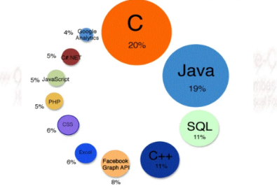
Programing languages

Slide 7

E-LEARNING HELPS
help in the evaluation of the learners
Quiz determines whether the learner
had qualified the course
Video Content is very helpful and reliable
Visuals help to understand better

Slide 8

Website created based on:
HTML:
HTML is a language that determines how documents and web pages are displayed in a web browser, the language for the building blocks of any website.
CSS:
CSS (Cascading Style Sheets) is a popular style sheet language that determines how a document created in HTML is styled (colors, font styles, layout and responsive features).
JAVASCRIPT:
JavaScript allows you to change CSS and HTML elements on your website after the site has been loaded, which gives you the ability to make your site more interactive and engaging for users.

Slide 9
Funtional and Non-funtional requirements
 | FUNTIONAL REQUIREMENTS | NON-FUNTIONAL REQUIREMENTS
OBJECTIVE | E-learning makes the delivery of learning and training through digital resources. | Content can be delivered to teams and individuals on-demand to their preferred devices, anytime, anywhere.
END RESULT | Providing multiple channels of acquiring knowledge. | self-paced and reaches a wider , E-learning is connected to electronic media and always have assessments.
FOCUS | a computer and an Internet connection. | the quality of learning and teaching, user-accessibility and time flexibility to engage learners in the learning process.
ESSENTIALITY | User friendly and flexible | Focus on more theory,cheating is un avoidable
TESTING | Tested before none funtional testing. | Tested after funtional testing.

Slide 10


